Slide 1
Annual Provider Training 2024
SCDHHS QIO Program

Slide 2
Meet our Company
With over six decades of combined experience, CNSI and Kepro have come together to become:

Slide 3
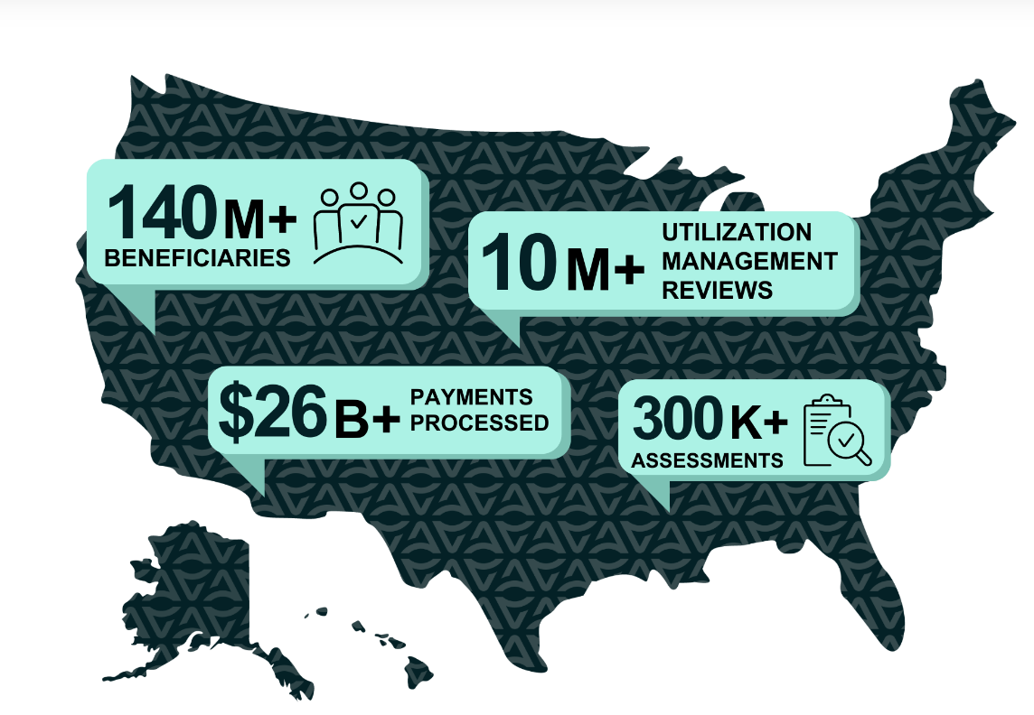
Our Footprint in over 45 States

Slide 4
Utilization Management & Quality Improvement
Acentra Health (formerly Kepro and CNSI) is the Utilization Management/Quality Improvement Organization (UMQIO) for the South Carolina Department of Health and Human Services (SCDHHS) Healthy Connections Fee For Service Medicaid program. We have been providing services for SCDHHS since 2012.
We are a team of experienced leaders, caring clinicians, pioneering technologists, and industry professionals who come together to redefine expectations for the industry.
We provide:
Medical necessity reviews for multiple services
Level of Care reviews
Post-Payment reviews

Slide 5
Acentra Health
Prior Authorization Process

Slide 6
Authorization Types
Prior Authorization
Should always be submitted on or before the service begins.
Retrospective Authorization “Retro”
Needed when services were performed before the member was eligible for Medicaid and the member has since been granted retrospective eligibility covering the date of service.
A Retro case is NOT one that is submitted late for any reason other than eligibility.
Untimely requests will be administratively denied.
Providers must identify a request as RETRO on the fax request form or by request type in Atrezzo.

Slide 7
Tips for Submission
Providers are responsible for checking member eligibility and benefit plan information prior to rendering services.
Please contact the appropriate Managed Care Organization for members enrolled in managed care.
Gather all pertinent clinical information and/or required forms to support medical necessity.
Submit authorization requests to Acentra Health for all eligible Fee For Service members.

Slide 8
Submitting a Request for Authorization
Providers are highly encouraged to use Atrezzo, the provider web portal to submit requests.
Efficient, easy access to enter and verify authorizations
Communicate with Acentra Health staff through secure messaging regarding authorizations when appropriate
View and print letters with ease
Reduces the “did you receive my fax” burden
Portal.Kepro.com to register for access
Step by step guide on using Atrezzo found in the Acentra Health Provider Manual

Slide 9
Submitting a Request for Authorization
Fax
Customer Service
Providers may use the Prior Authorization Request form.
fax to 1-855-300-0082
Prior Authorization request forms can be found at https://scdhhs.acentra.com/forms
Be sure to use the correct form for service type
Must submit with required clinical information or case will be pended as insufficient.
Call 1-855-326-5219.
Least preferred method.
Calling to “start a case” only delays your request. Case will be pended for insufficient information and/or required clinical information before a proper review can begin.
Once clinical information is received, the case will be reviewed for medical necessity.

Slide 10
Processing Timelines
Acentra Health completes requests for services expeditiously and within contractual timeframes. The review completion timeframe is measured from the date Acentra Health receives a request.
New Request/Admission review – 5 business days for all requests except DME. DME will be processed within 15 business days
Retrospective Reviews – 5 business days

Slide 11
Review Process
Administrative Requirements
Nurse Review
Physician Review
InterQual® or State defined criteria applied
May pend for additional clinical information
Approve if criteria met
Refer to physician reviewer if documentation does not support medical necessity.
The medical director, or another qualified physician reviewer will review the case against InterQual® or State defined criteria and national standards to provide a decision.
The physician or qualified practitioner may approve or deny the review.
Member eligibility verification
Provider eligibility verification
Medicaid Guidelines applied

Slide 12
Pended Reviews
A review may be pended for one of the following reasons:
Missing required information such as plan of care or provider number
Additional information or clarification is needed before a decision can be made
Notifications are sent via fax or web portal.
A provider has 2 business days to respond to the additional information request.
A provider has 2 business days to respond to the additional information request
If the case contains no clinical information, the case will be administratively denied.
If the case has insufficient clinical information and there is no response to the pended, the case will move to the physician reviewer for a determination.
If a review is administratively denied, the provider may submit a new request once they have all the necessary information. Administratively denied request do not qualify for reconsideration.

Slide 13
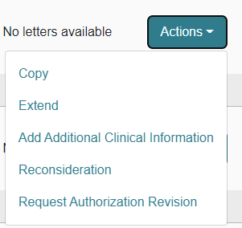
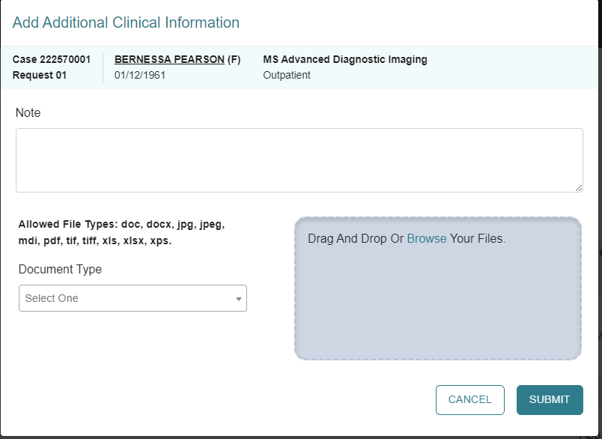
Responding to Pended Reviews
If you submitted the request online thru the Portal:
Log into the Portal and open the pended case.
ACTION TAB – additional Clinical Information.
Upload the requested documents or type the information in the note section.

Slide 14
Denials and Reconsiderations
Administrative Denial
When any portion of the review is denied because it does not comply with Medicaid regulations
Example: untimely, insufficient clinical information
Clinical Denial
Occurs when any portion of the requested service is denied by a physician reviewer due to medical necessity
Does not meet state Medicaid criteria with information submitted or does not meet other national evidence-based criteria
Reconsideration
May only be requested for clinically denied cases
Provider may submit a new case for the service if a administrative denial is received. This does not apply to those cases that were denied for untimely submission.
Not used for Administrative Denials

Slide 15
Reconsiderations
May be submitted within 60 days of the clinical denial date
This is your opportunity to provide more detailed clinicals to support medical necessity.
May be submitted via
Web portal *preferred
Fax
phone *least preferred (will still be require to fax additional information)
A clinical reviewer will review any additional information submitted. If unable to meet InterQual® or State approved criteria, it will be referred to the physician reviewer.
A physician reviewer – a different physician from the one who originally reviewed the case - will look at the case and any new information submitted to support the reconsideration.
The physician reviewer may
Uphold original decision (no change made).
Overturn the original decision (approve the case).
If original denial decision is upheld, an appeal may be submitted to SCDHHS.
Notes:
Need to clarify how many days they have to submit a reconsideration…

Slide 16
Appeals
If a reconsideration is upheld, an appeal may be requested. Specific instructions will be included in the reconsideration determination letter sent to the provider and member.
SCDHHS will review the request and conduct a Fair hearing.
Members may request an appeal within 30 calendar days from the reconsideration determination notice:
online at www.scdhhs.gov/appeals,
Fax 803 255 8206
Email appeals@scdhhs.gov
Mail Office of Appeals and Hearings
PO BOX 8206
Columbia, SC 29202
Notes:
Verify this information

Slide 17
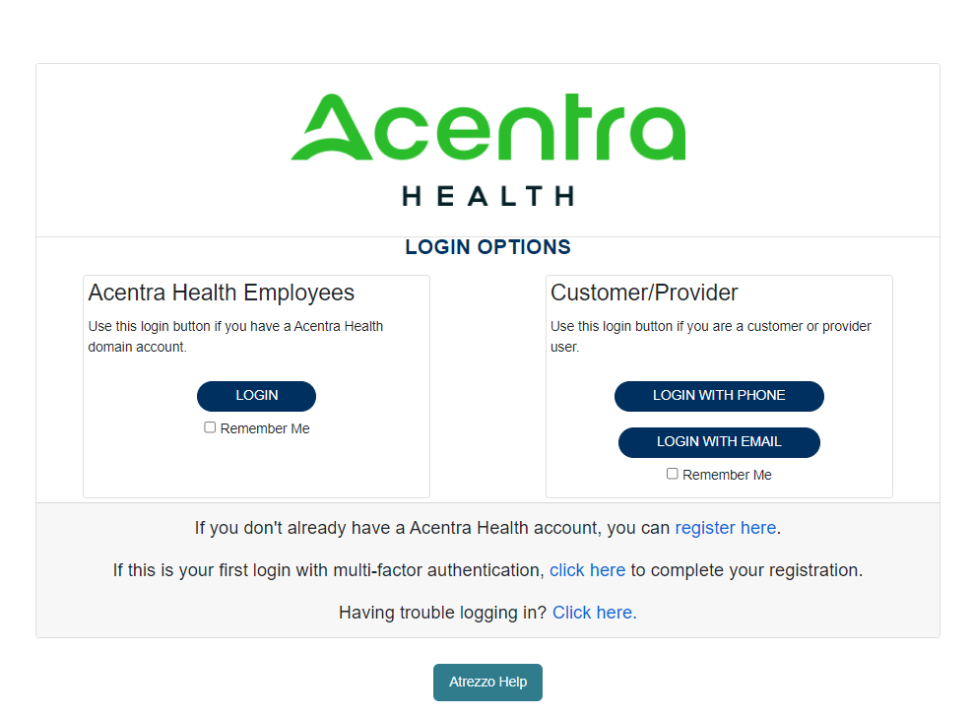
Atrezzo – Registering for the Portal

Slide 18
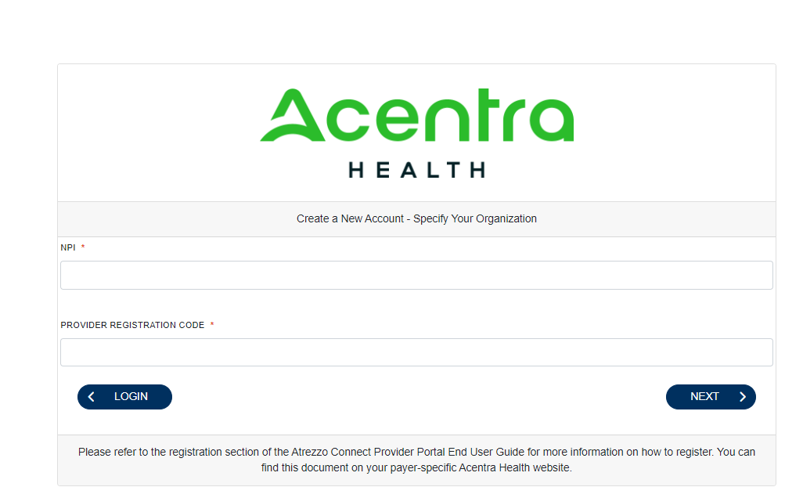
ANG Registration
**Please contact the customer service line at 1-855-326-5219 if you have questions before you attempt to register. Your organization may already be registered for the portal.
NPI number
Medicaid ID number

Slide 19
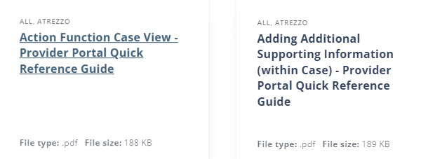
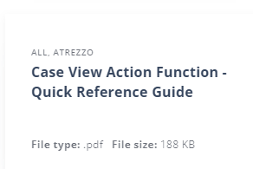
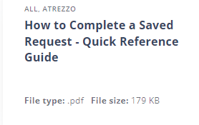
ANG Training Videos
Acentra training page (https://scdhhs.acentra.com/resources-and-training/#training)

Slide 20
Resources and Education
SCDHHS Healthy Connections Medicaid
Provider Training Resources | SCDHHS
SC Acentra Health website
Acentra Health Customer Service
1-855-326-5219
scproviderissues@kepro.com generic questions please, do not include PHI

