Slide 1
South Carolina
Department of Health & Human services
Provider Transplant Training
Q1 2022

Slide 2
Part One
Introduction to Kepro

Slide 3
Kepro’s Mission
Kepro’s mission is to improve lives through healthcare quality and clinical expertise.
We work on behalf of government and private healthcare payers to maximize healthcare quality, improve accuracy and increase efficiency.
As a result, we drive real change in the healthcare system that allow healthcare dollars to reach more people by ensuring the right care is delivered at the right time.

Slide 4
Kepro at a Glance
Currently servicing 250 state, federal and employer clients
URAC accredited in UM, CM, DM, & IRO
14 offices and more than 1,000 employees
Over 3,000 credentialed physicians and 500 clinicians on our Advisory and Review panel
Currently holds both QIO and QIO-like designations
Kepro provides Care Management, Quality Oversight, and Assessments, Eligibility & Enrollment services

Slide 5
Kepro and SCDHHS Relationship
Kepro has held a contract with SCDHHS for Utilization Management and quality of care services since 2012.
Addition of New Programs / Service Lines in 2019 -2021
BRCA
Fetal DNA
Hospice therapies
ASD
Kepro has a high degree of expertise and knowledge in Utilization Management and Level of Care Screening in statewide programs.

Slide 6
Instructions for Obtaining Prior Approval
Requests for prior authorizations from Kepro may be submitted using one of the following methods:
Atrezzo Provider Portal
Kepro Customer Service: +1 855 326 5219
Kepro Fax: +1 855 300 0082

Slide 7
Transplants

Slide 8
Transplants
Per Medicaid Bulletin MB# 21-013 dated Dec. 1, 2021: Effective Jan. 1, 2022, the South Carolina Department of Health and Human Services (SCDHHS) will accept prior approval of an organ transplant by the agency’s quality improvement organization (QIO) as approval for a Healthy Connections Medicaid member to be treated out of state, if applicable. The agency’s QIO is Keystone Peer Review Organization (Kepro). Providers must continue to contact Kepro for prior authorization before rendering transplant services.
Effective Jan. 1, 2022, SCDHHS requires providers to obtain prior authorization for all organ transplant services rendered to South Carolina Healthy Connections Medicaid members.
This policy and its requirements are included in section 7 of SCDHHS’ Hospital Services provider manual.:

Slide 9
Transplants
Referral requests for organ transplants to both in-State and out-of-State centers must be submitted to the QIO, Kepro, before the services are rendered.
Upon approval, Kepro will issue an approval letter. The approval letter will serve as authorization for pre-transplant services (72 hours pre-admission), the transplant event (Hospital admission through discharge), and post-transplant services up to 90 days from the date of discharge. The letter will also contain an authorization number that must be entered in the prior authorization field of all UB-04 and the CMS-1500 claim forms submitted for reimbursement.
Please note:
The approval of a transplant evaluation does not guarantee the approval of the actual transplant.
Pre-transplant admission for chemotherapy and/or cell harvest may require inpatient prior authorization (follow policy of primary insurance carrier for inpatient admission).

Slide 10
Tips for Transplant Submission
  Requests should include the Transplant Prior Authorization Request Form, a letter from the attending Physician that describes the type of transplant needed, the patient’s current medical status, course of treatment, and the name of the center to which the patient is being referred.
  Transplant auths are issued for 365 days from date of PA request.
  ALL transplant authorizations by Kepro include coverage for inpatient admission up to 72 hours prior to transplant surgery. (and all transplant-related follow-up or readmissions for up to 90 days post-transplant surgery date).
  Pre-transplant evaluations remain the responsibility of the primary payor as they are done on an outpatient basis and Kepro DOES NOT review/authorize these.

Slide 11
Tips for Transplant Submission
  For transplants that are requested to be done out of state:
    Transplant services must not be available in SC
    If services are available in SC, provider should contact SC Medicaid Provider Service Center at 1-888-289-0709 for out-of-state transplant evaluation approval OR waiver for transplant.
    If approval received from SCDHHS/Medicaid , Kepro can review for transplant.
  Fax Submissions require Kepro Prior Authorization Fax Form – Transplant and Surgical justification
  Kepro forms found on https://scdhhs.Kepro.com/content/forms.aspx
  Transplant Prior Authorization Request Form found on https://www.scdhhs.gov/internet/pdf/manuals/Hospital/Forms.pdf

Slide 12
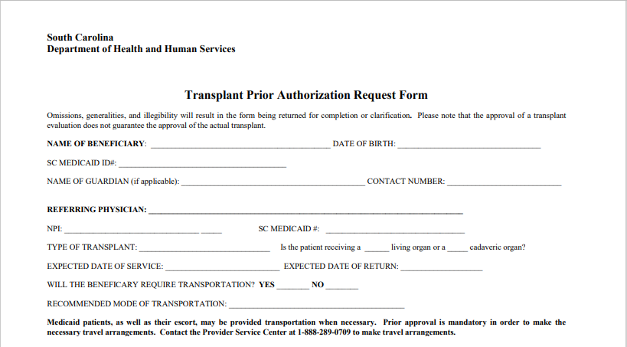
Transplants

Slide 13
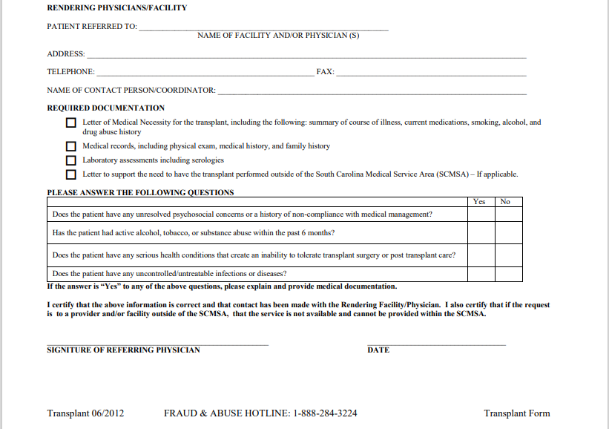
Transplants

Slide 14
Miscellaneous Tips

Slide 15
Tips for Review Criteria
InterQual
When additional information is requested, please address the specific questions asked.
If nurse reviewer is unable to meet criteria with supplied clinical information (including additional clinical received after requested), case will be forwarded for physician review.

Slide 16
Medical Necessity Denials
Medical necessity denials are denials where clinical information that has been submitted has been reviewed by a Physician who has determined that the request is not medically necessary (based on the clinical submitted).
If you disagree with denial decision, please follow instructions as outlined in your denial letter.
Reconsideration request- Submit to Kepro within 60 days from receipt of denial letter.
Appeals request- Submit to State within 30 days of receipt of denial letter. Appeals should be submitted after a reconsideration review has been completed.

Slide 17
Administrative Denials
Administrative denials are denials in which the request for services was submitted untimely or required SCDHHS forms were not submitted.
Administrative denials are administered by the Clinical Nurse Reviewer.
Administrative denials do not allow for reconsiderations, only appeals directly to SCDHHS.
Appeals request- Submit to state within 30 days of receipt of denial letter.

Slide 18
Turnaround Timeframes
Response Time for Decisions from the QIO
For all service types excluding DME and PRTF/Freestanding Psych, Kepro must render a decision within 5 business days.
Kepro has 15 days to process DME requests.
For beneficiaries under age twenty-one (21) receiving services in an Inpatient Psychiatric setting or Residential Treatment Facility, Kepro has 2 business days to process requests.
If a review requires a physician consultation, Kepro will have one (1) additional business day to render the decision.
NOTE: Requests for additional information by Kepro must be received within two (2) business days of the requested date from the provider.
Reference Medicaid Bulletin MB# 14-008 dated March 27, 2014.

Slide 19
Where to Access Training Materials and Forms
Visit Kepro's website to access training material, training dates, direct access to Atrezzo Provider system, forms, and more!
scdhhs.kepro.com

