Slide 1
Outpatient Therapies:
Physical Therapy, Occupational Therapy &
Speech Therapy
Provider Education 2024

Slide 2
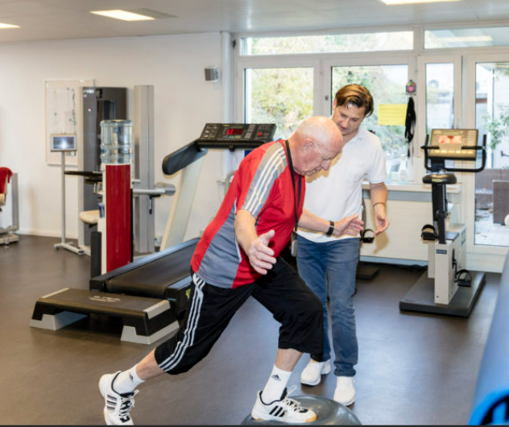
Outpatient Therapy Services: PT, OT & ST
South Carolina Medicaid covers medically necessary services to Medicaid-eligible individuals. This includes, children, adults, as well as any individual covered under the Head and Spinal Cord Injury Waivers (HASCI).

Slide 3

Outpatient Therapy Services: PT, OT & ST
21 years old and older
Services may be rendered in an office or outpatient setting
Prior Authorization is required for therapy services. Evaluations do not require PA.
Under 21 years of age
Services may be rendered in an office or outpatient setting
Prior authorization is required ONLY when therapy services exceed 420 units per fiscal year for combined rehabilitative therapy.
Providers are required to track and request the additional visits prior to exceeding the combined limit (Providers may use the SC Medicaid Portal to track requests)

Slide 4

Changes for 2024
Effective 2/1/24, evaluations/re-evaluations no longer require a prior authorization
CPT 97165 CPT 97161 CPT 92521
CPT 97166 CPT 97162 CPT 92522
CPT 97167 CPT 97163 CPT 92523
CPT 97168 CPT 97164 CPT 92524
CPT 92607
CPT 92608
CPT 92610
CPT S9152

Slide 5
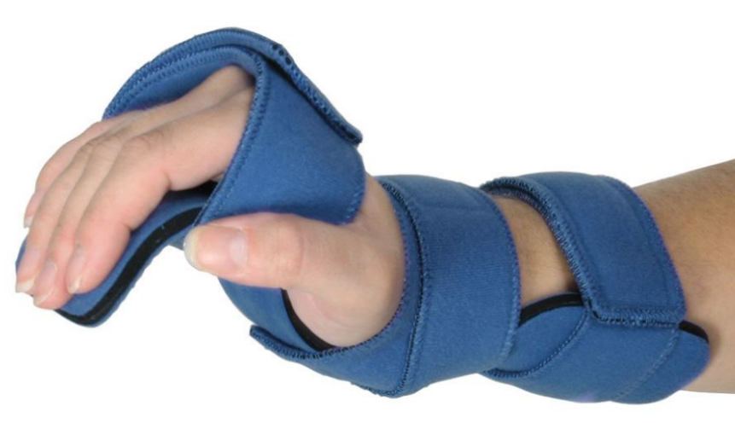
Changes for 2024
Effective 2/1/24, the following codes REQUIRE a prior authorization
L3808
L3999
92526 *All adults; pediatrics after the 420 unit maximum

Slide 6

Prior Authorization Requests
Authorization requests should be submitted prior to services being rendered
Authorization requests may be submitted online at https://portal.kepro.com or by fax using the Outpatient Prior Authorization Request form

Slide 7
Prior Authorization Requests
Initial Review Request
Concurrent Reviews
Clinical documentation should include:
Individual Plan of Care (IPOC)
Short-term and long-term goals
Home Exercise program
*approval period is 4 weeks
Clinical documentation should include:
Individual Plan of Care (IPOC)
Progress of short-term and long-term goals: have they been met, barriers, attendance and reason for missed visits
Home exercise program update
Patient/caregiver compliance with home exercise program
**progress summaries must be current, and include progress from the authorization period

Slide 8

Outpatient Therapy Notes
Refer to the SCDHHS Private Rehabilitative Therapy & Audiological Services Provider Manual for detailed program information
Requests submitted close to the end of the Medicaid fiscal year (June 30) will have an end date of June 30 due to the benefit reset on July 1 each year. *Only applies to members under the age of 21.

Slide 9

Authorization Types
Prior Authorization
  Should always be submitted before the service is performed.
Retrospective Authorization “Retro”
  Needed when services were performed before the member was eligible for Medicaid and the member has since been granted retrospective eligibility covering the date of service.
  A Retro case is NOT one that is submitted late for any reason other than eligibility.
Untimely requests will be administratively denied.
Providers must identify a request as RETRO on the fax request form or by request type in Atrezzo.

Slide 10

Processing Timelines
Acentra Health completes requests for services expeditiously and within contractual timeframes. The review completion timeframe is measured from the date Acentra Health receives a request.
  New Request/Admission review – 5 business days
  Retrospective Reviews – 5 business days

Slide 11



Review Process
Administrative Requirements
Nurse Review
Physician Review
InterQual® or State defined criteria applied
May pend for additional clinical information
Approve if criteria met
Refer to physician reviewer if documentation does not support medical necessity.
The medical director, or another qualified physician reviewer will review the case against InterQual® or State defined criteria and national standards to provide a decision
The physician or qualified practitioner may approve or deny the review
Member eligibility verified
Provider eligibility verified
Medicaid Guidelines applied

Slide 12

Pended Reviews
A review may be pended for one of the following reasons:
  Missing required information such as plan of care or provider number
  Additional information or clarification is needed before a decision can be made
Notifications are sent via fax or web portal
A provider has 2 business days to respond to the additional information request
  If the case contains no clinical information, the case will be administratively denied.
  If the case has insufficient clinical information and there is no response to the pended, the case will move to the physician reviewer for a determination.
If a review is administratively denied, the provider may submit a new request once they have all the necessary information.

Slide 13
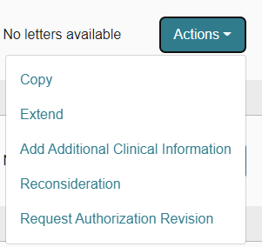
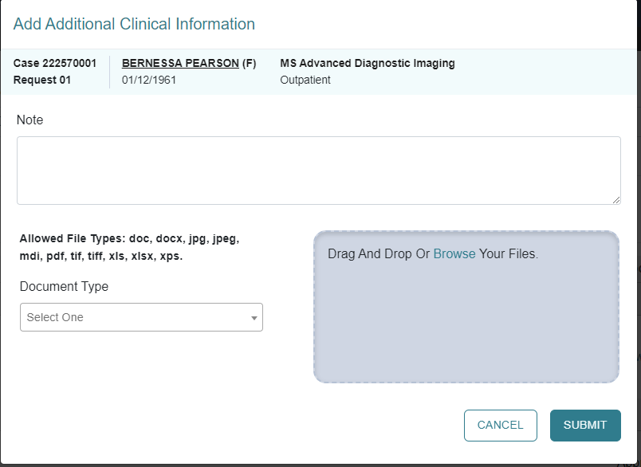
Responding to Pended Reviews
If you submitted the request online thru the Portal:
  Log into the Portal and open the pended case
  ACTION TAB – additional Clinical Information
  Upload the requested documents or type the information in the note section.

Slide 14
Denials and Reconsiderations
Administrative Denial
When any portion of the review is denied because it does not comply with Medicaid regulations
Example: untimely, insufficient information
Clinical Denial
Occurs when any portion of the requested service is denied by a physician reviewer due to medical necessity
Does not meet state Medicaid criteria with information submitted or does not meet other national evidence-based criteria
Reconsideration
May only be requested for clinically denied cases
Provider may submit a new case for the service if an administrative denial is received. This does not apply to those cases that were denied for untimely submission.
Not used for Administrative Denials

Slide 15

Reconsiderations
May be submitted within 60 calendar days of the clinical denial date
  This is your opportunity to provide more detailed clinicals
May be submitted via
  Web portal *preferred
  Fax
A clinical reviewer will review any additional information submitted. If unable to meet InterQual® or State approved criteria, it will be referred to the physician reviewer.
A physician reviewer – a different physician from the one who originally reviewed the case - will look at the case and any new information submitted to support the reconsideration
The physician reviewer may
  Uphold original decision (no change made)
  Overturn the original decision (approve the case)
If original denial decision is upheld, an appeal may be submitted to SCDHHS.
Notes:
Need to clarify how many days they have to submit a reconsideration…

Slide 16

Appeals
If a reconsideration is upheld, an appeal may be requested. Specific instructions will be included in the reconsideration determination letter.
SCDHHS will review the provider’s request and conduct a Fair hearing
Members may request an appeal within 30 calendar days
  online at www.scdhhs.gov/appeals,
  Fax 803 255 8206
  Email appeals@scdhhs.gov
  Mail Office of Appeals and Hearings
    PO BOX 8206
    Columbia, SC 29202
Notes:
Verify this information

Slide 17

Resources and Education
Rehabilitative Therapy Audiological Services Manual
Provider Training Resources | SCDHHS
SC Acentra Health website
Acentra Health Customer Service
  1-855-326-5219
  scproviderissues@kepro.com generic questions please, do not include PHI

