Slide 1
Organ Transplants & Transplant Related Services
Provider Education 2024

Slide 2
Organ Transplants and Transplant-Related Services
South Carolina Medicaid covers medically necessary and non-investigational/experimental organ and tissue transplant and transplant-related services.
SCDHHS will only support the referral of patients for an evaluation to CMS certified transplant centers. This will include certified facilities that are contracted with SCDHHS as well as certified facilities that are located outside of the SCMSA (more than 25 miles of the South Carolina borders). For a complete list of CMS-approved centers, visit the CMS website at https://www.cms.gov/Medicare/Provider-Enrollment-andCertification/CertificationandComplianc/Transplant.htm.
Effective 2/1/2024 Acentra Health will no longer provide transplant authorization services for MCO members. Providers will need to contact the member’s MCO directly for all pretransplant, surgery, and post transplant needs.

Slide 3

Transplant Groups
Group I
Corneal
Kidney
*The above transplants are covered in all medically necessary instances. Prior authorization is not required.
Group II
Pancreas
Heart
Liver
Liver w/ small bowels
Lung
Bone Marrow/Stem Cell
Multi-organ
* Group II transplants require prior authorization

Slide 4

Prior Authorization Requests
Authorization requests should be submitted prior to services being rendered.
Authorization requests may be submitted online at https://portal.kepro.com or by fax using the Transplant Prior Authorization Request form.

Slide 5

Prior Authorization Requests
Required Documentation to be submitted with request includes, but is not limited to -
Transplant Prior Authorization Request Form
  Clinical documentation outlined at the bottom of this form
Letter from the attending physician with
  Description of transplant needed.
  Patient’s current medical status.
  Patient’s course of treatment.
  Name of the center to which the patient is being referred.

Slide 6

Transplant Notes
Acentra Health does not review/authorize outpatient pre-transplant services, including the transplant evaluation.
Authorizations are issued for 365 days.
Authorizations include coverage for inpatient admission up to 72 hours prior to transplant surgery AND all transplant related follow up or readmission for up to 90 days post transplant surgery date.
Authorization number must be submitted in the appropriate fields of the UB-04 and the CMS-1500 claim forms.

Slide 7

Transplant Notes
For transplants that are requested to be performed out of state:
Transplant services must not be available in SC.
If services are available in SC, provider must contact SC Medicaid Provider Services at 1-888-289-0709 for an out of state transplant evaluation approval OR waiver for transplant.
If an out of state approval is received from SCDHHS, Acentra Health can proceed with review for transplant.

Slide 8

Authorization Types
Prior Authorization
  Transplant Prior Authorization request must be submitted at least 10 days prior to planned transplant.
Retrospective Authorization “Retro”
  Needed when services were performed before the member was eligible for Medicaid and the member has since been granted retrospective eligibility covering the date of service.
  A Retro case is NOT one that is submitted late for any reason other than eligibility.
Untimely requests will be administratively denied.
Providers must identify a request as RETRO on the fax request form or by request type in Atrezzo.
  **not applicable to Transplant Services

Slide 9

Processing Timelines
Acentra Health completes requests for services expeditiously and within contractual timeframes. The review completion timeframe is measured from the date Acentra Health receives a request.
  New Request/Admission review – 5 business days
  Retrospective Reviews – 5 business days

Slide 10



Review Process
Administrative Requirements
Nurse Review
Physician Review
InterQual® or State defined criteria applied
May pend for additional clinical information
Approve if criteria met
Refer to physician reviewer if documentation does not support medical necessity
The medical director, or another qualified physician reviewer will review the case against InterQual® or State defined criteria and national standards to provide a decision.
The physician or qualified practitioner may approve or deny the review.
Member eligibility verified
Provider eligibility verified
Medicaid Guidelines applied

Slide 11

Pended Reviews
A review may be pended for one of the following reasons:
  Missing required information such as plan of care or provider number
  Additional information or clarification is needed before a decision can be made
Notifications are sent via fax or web portal.
A provider has 2 business days to respond to the additional information request
  If the case contains no clinical information, the case will be administratively denied.
  If the case has insufficient clinical information and there is no response to the pended, the case will move to the physician reviewer for a determination.
If a review is administratively denied, the provider may submit a new request once they have all the necessary information.

Slide 12
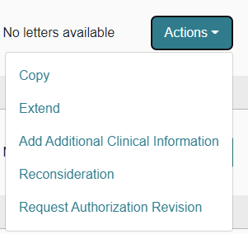
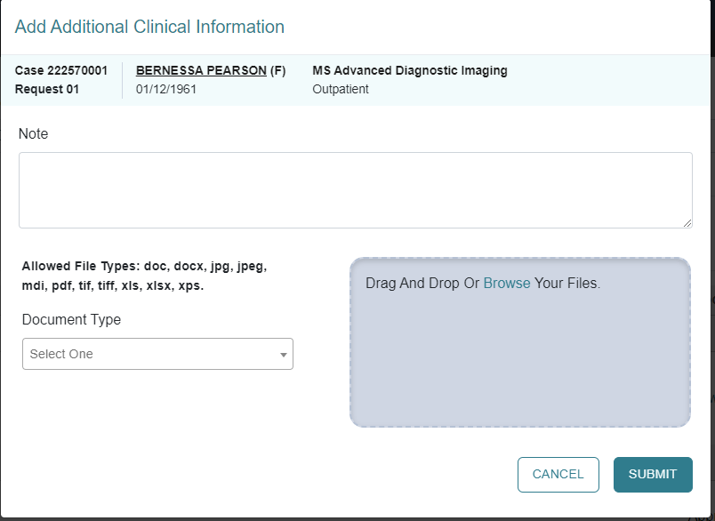
Responding to Pended Reviews
If you submitted the request online thru the Portal:
  Log into the Portal and open the pended case.
  ACTION TAB – additional Clinical Information.
  Upload the requested documents or type the information in the note section.

Slide 13
Denials and Reconsiderations
Administrative Denial
When any portion of the review is denied because it does not comply with Medicaid regulations
Example: untimely, insufficient information
Clinical Denial
Occurs when any portion of the requested service is denied by a physician reviewer due to medical necessity
Does not meet state Medicaid criteria with information submitted or does not meet other national evidence-based criteria
Reconsideration
May only be requested for clinically denied cases
Provider may submit a new case for the service if an administrative denial is received. This does not apply to those cases that were denied for untimely submission.
Not used for Administrative Denials

Slide 14

Reconsiderations
May be submitted within 60 days of the clinical denial date
  This is your opportunity to provide more detailed clinicals
May be submitted
  Via phone (will still require additional information to be faxed)
  Fax
  Web portal *preferred
A clinical reviewer will review any additional information submitted. If unable to meet InterQual® or State approved criteria, it will be referred to the physician reviewer.
A physician reviewer – a different physician from the one who originally reviewed the case - will look at the case and any new information submitted to support the reconsideration.
The physician reviewer may
  Uphold original decision (no change made).
  Overturn the original decision (approve the case).
If original decision is upheld, provider may appeal the decision to SCDHHS.

Slide 15

Appeals
If a reconsideration is upheld, an appeal may be requested. Specific instructions will be included in the reconsideration determination letter.
SCDHHS will review the provider’s request and conduct a Fair hearing.
Members may request an appeal within 30 calendar days from the reconsideration determination notice:
  online at www.scdhhs.gov/appeals,
  Fax 803 255 8206
  Email appeals@scdhhs.gov
  Mail Office of Appeals and Hearings
    PO BOX 8206
    Columbia, SC 29202
Notes:
Verify this information

Slide 16

Resources and Education
Organ Transplant Services, found in the Hospital Services Provider Manual
Provider Training Resources | SCDHHS
SC Acentra Health website
Acentra Health Customer Service
  1-855-326-5219
  scproviderissues@kepro.com generic questions please, do not include PHI

